Slide 1
Digital Logic Design
Lecture 17
Chapter 3 <number>

Slide 2
Selecting
Selecting of data or information is a critical function in digital systems and computers
Circuits that perform selecting have:
  A set of information inputs from which the selection is made
  A single output
  A set of control lines for making the selection
Logic circuits that perform selecting are called multiplexers
Selecting can also be done by three-state logic or transmission gates
Chapter 3 <number>

Slide 3
Multiplexers
A multiplexer selects information from an input line and directs the information to an output line
A typical multiplexer has n control inputs (S_{n − 1}, … S₀) called selection inputs, 2^{n} information inputs (I₂^{n} ₋ ₁, … I₀), and one output Y
A multiplexer can be designed to have m information inputs with m < 2^{n} as well as n selection inputs
Chapter 3 <number>

Slide 4
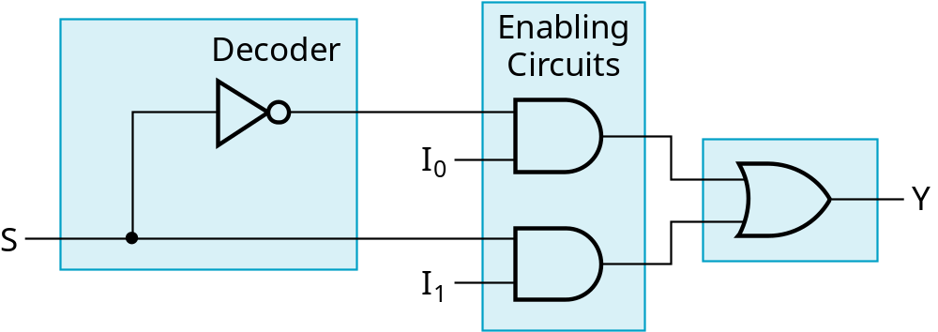
2-to-1-Line Multiplexer
Since 2 = 2¹, n = 1
The single selection variable S has two values:
  S = 0 selects input I₀
  S = 1 selects input I₁
The equation:
Y = I₀ + SI₁
The circuit:
S
Chapter 3 <number>

Slide 5
2-to-1-Line Multiplexer (continued)
Note the regions of the multiplexer circuit shown:
  1-to-2-line Decoder
  2 Enabling circuits
  2-input OR gate
To obtain a basis for multiplexer expansion, we combine the Enabling circuits and OR gate into a 2 × 2 AND-OR circuit:
  1-to-2-line decoder
  2 × 2 AND-OR
In general, for an 2^{n}-to-1-line multiplexer:
  n-to-2^{n}-line decoder
  2^{n} × 2 AND-OR
Chapter 3 <number>

Slide 6
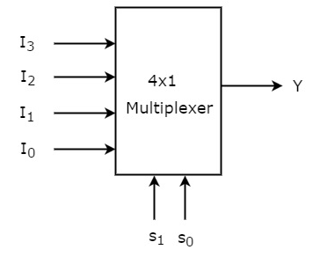
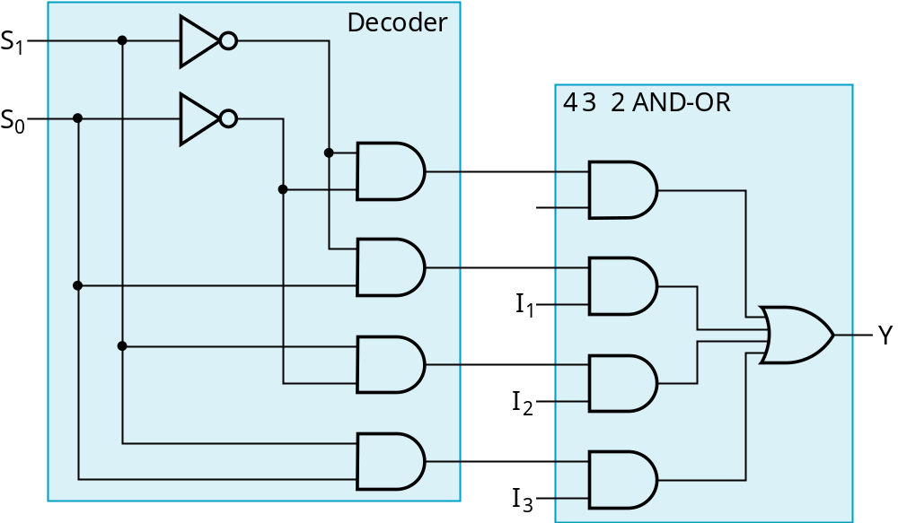
Example: 4-to-1-line Multiplexer
2-to-2²-line decoder
2² × 2 AND-OR
Chapter 3 <number>

Slide 7
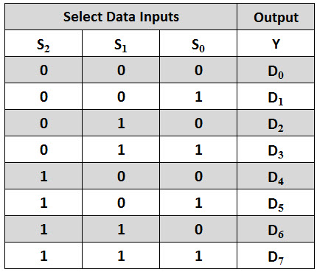
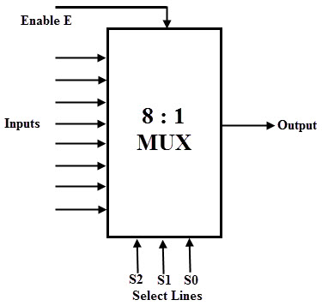
Example: 8-to-1-line Multiplexer
Chapter 3 <number>

Slide 8
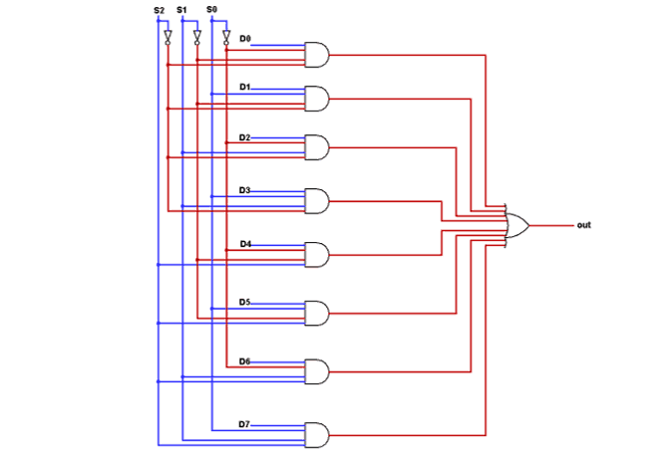

Example: 8-to-1-line Multiplexer
Chapter 3 <number>

Slide 9
Multiplexer Expansion
8-to-1 MUX using Dual 4-to-1 MUX
MUX
I0
I1
I2
I3
I0
I1
I2
I3
I4
I5
I6
I7
Y
S1 S0
MUX
I0
I1
Y
Y
MUX
S
I0
I1
I2
I3
Y
S1 S0
1
0 0
S2 S1 S0
Notes:
Princess Sumaya University
4241 - Digital Logic Design
Dr. Bassam Kahhaleh

Slide 10
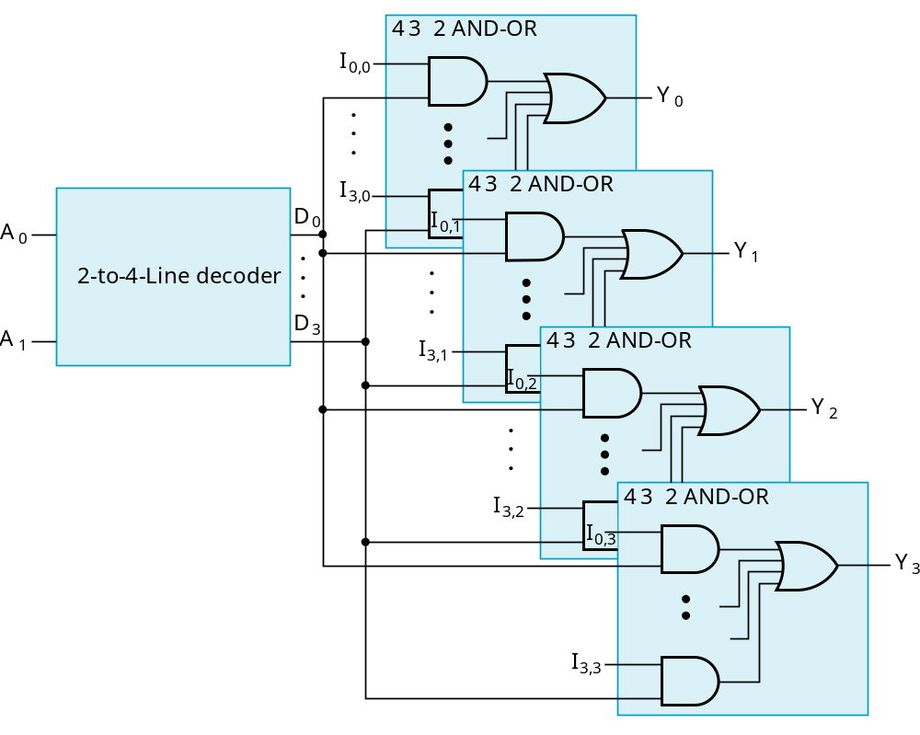
Multiplexer Width Expansion
Select “vectors of bits” instead of “bits”
Use multiple copies of 2^{n} × 2 AND-OR in parallel
Example:
4-to-1-line
quad multi-
plexer
Chapter 3 <number>

Slide 11
Combinational Logic Implementation
- Multiplexer Approach 1
Implement m functions of n variables with:
  Sum-of-minterms expressions
  An m-wide 2^{n}-to-1-line multiplexer
Design:
  Find the truth table for the functions.
  In the order they appear in the truth table:
    Apply the function input variables to the multiplexer inputs S_{n − 1}, … , S₀
    Label the outputs of the multiplexer with the output variables
  Value-fix the information inputs to the multiplexer using the values from the truth table (for don’t cares, apply either 0 or 1)
Chapter 3 <number>

Slide 12
Example: Gray to Binary Code
Design a circuit to
convert a 3-bit Gray
code to a binary code
The formulation gives
the truth table on the
right
It is obvious from this
table that X = C and the
Y and Z are more complex
Gray
Binary
A B C
x y z
0
0
0
0
0
0
1 0
0
0
0 1
1
1 0
0 1 0
0 1 0
0 1
1
0 1
1
1 0
0
1
1
1
1 0 1
1 0 1
1
1 0
0
0 1
1
1
1
Chapter 3 <number>

Slide 13
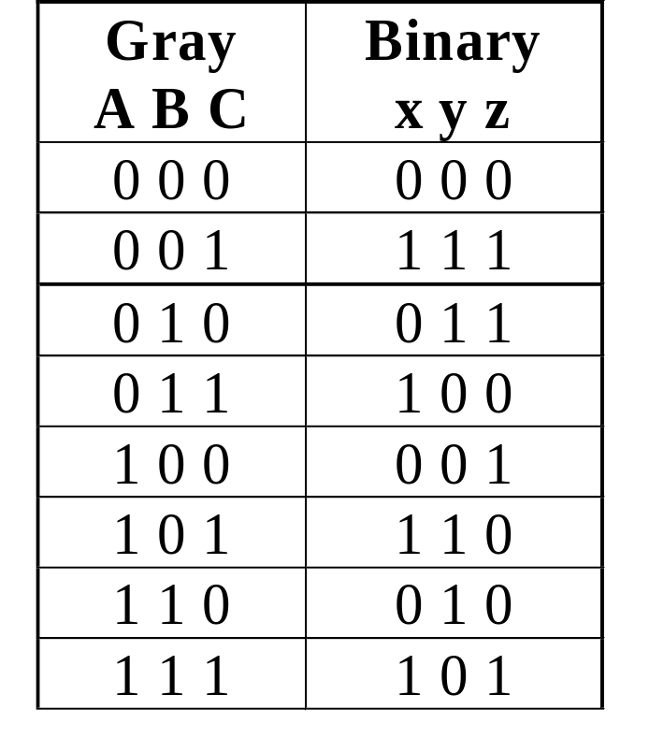
Gray to Binary (continued)
Rearrange the table so
that the input combinations
are in counting order
Functions y and z can
be implemented using
a dual 8-to-1-line
multiplexer by:
  connecting A, B, and C to the multiplexer select inputs
  placing y and z on the two multiplexer outputs
  connecting their respective truth table values to the inputs
Chapter 3 <number>

Slide 14
Gray to Binary (continued)
Note that the multiplexer with fixed inputs is identical to a ROM with 3-bit addresses and 2-bit data!
0
D00
0
D10
1
D01
1
D11
1
D02
1
D12
0
D03
0
D13
0
D04
1
D14
1
Out
Y
0
Out
Z
D05
D15
1
D06
0
D16
0
D07
1
D17
A
S2
A
S2
8-to-1
8-to-1
B
S1
B
S1
MUX
S0
MUX
C
S0
C
Chapter 3 <number>

Slide 15
Combinational Logic Implementation
- Multiplexer Approach 2
Implement any m functions of n + 1 variables by using:
  An m-wide 2^{n}-to-1-line multiplexer
  A single inverter
Design:
  Find the truth table for the functions.
  Based on the values of the first n variables, separate the truth table rows into pairs
  For each pair and output, define a rudimentary function of the final variable (0, 1, X, )
  Using the first n variables as the index, value-fix the information inputs to the multiplexer with the corresponding rudimentary functions
  Use the inverter to generate the rudimentary function
X
X
Chapter 3 <number>

Slide 16
Example: Gray to Binary Code
Design a circuit to
convert a 3-bit Gray
code to a binary code
The formulation gives
the truth table on the
right
It is obvious from this
table that X = C and the
Y and Z are more complex
Gray
Binary
A B C
x y z
0
0
0
0
0
0
1 0
0
0
0 1
1
1 0
0 1 0
0 1 0
0 1
1
0 1
1
1 0
0
1
1
1
1 0 1
1 0 1
1
1 0
0
0 1
1
1
1
Chapter 3 <number>

Slide 17
Gray to Binary (continued)
Rearrange the table so that the input combinations are in counting order, pair rows, and find rudimentary functions
Gray A B C | Binary x y z | Rudimentary Functions of C for y | Rudimentary Functions of C for z
0 0 0 | 0 0 0
0 0 1 | 1 1 1
0 1 0 | 0 1 1
0 1 1 | 1 0 0
1 0 0 | 0 0 1
1 0 1 | 1 1 0
1 1 0 | 0 1 0
1 1 1 | 1 0 1
F = C
F = C
F = C
F = C
F = C
F = C
F = C
F = C
Chapter 3 <number>

Slide 18
Gray to Binary (continued)
Assign the variables and functions to the multiplexer inputs:
Note that this approach (Approach 2) reduces the cost by almost half compared to Approach 1.
This result is no longer ROM-like
Extending, a function of more than n variables is decomposed into several sub-functions defined on a subset of the variables. The multiplexer then selects among these sub-functions.
C
D00
C
D10
C
D01
C
D11
C
C
C
D02
Out
Y
C
D12
Out
Z
C
D03
C
D13
A
S1
8-to-1
A
S1
8-to-1
B
S0
MUX
B
S0
MUX
Chapter 3 <number>

Slide 19
Implementation Using Multiplexers
Example
F(x, y) = ∑(0, 1, 3)
x y | F
0 0 | 1
0 1 | 1
1 0 | 0
1 1 | 1
MUX
1
1
0
1
I0
I1
I2
I3
Y
F
S1 S0
x y
Notes:
Princess Sumaya University
4241 - Digital Logic Design
Dr. Bassam Kahhaleh

Slide 20
Implementation Using Multiplexers
Example
F(x, y, z) = ∑(1, 2, 6, 7)
MUX
0
1
1
0
0
0
1
1
I0
I1
I2
I3 I4
I5
I6
I7
x y z | F
0 0 0 | 0
0 0 1 | 1
0 1 0 | 1
0 1 1 | 0
1 0 0 | 0
1 0 1 | 0
1 1 0 | 1
1 1 1 | 1
Y
F
S2 S1 S0
x y z
Notes:
Princess Sumaya University
4241 - Digital Logic Design
Dr. Bassam Kahhaleh

Slide 21
Implementation Using Multiplexers
Example
F(x, y, z) = ∑(1, 2, 6, 7)
x y z | F
0 0 0 | 0
0 0 1 | 1
0 1 0 | 1
0 1 1 | 0
1 0 0 | 0
1 0 1 | 0
1 1 0 | 1
1 1 1 | 1
z
MUX
I0
I1
I2
I3
F = z
F
z
0
Y
F = z
1
S1 S0
F = 0
x y
F = 1
Notes:
Princess Sumaya University
4241 - Digital Logic Design
Dr. Bassam Kahhaleh

Slide 22
Implementation Using Multiplexers
Example
F(A, B, C, D) = ∑(1, 3, 4, 11, 12, 13, 14, 15)
A B C D | F
0 0 0 0 | 0
0 0 0 1 | 1
0 0 1 0 | 0
0 0 1 1 | 1
0 1 0 0 | 1
0 1 0 1 | 0
0 1 1 0 | 0
0 1 1 1 | 0
1 0 0 0 | 0
1 0 0 1 | 0
1 0 1 0 | 0
1 0 1 1 | 1
1 1 0 0 | 1
1 1 0 1 | 1
1 1 1 0 | 1
1 1 1 1 | 1
MUX
D
I0
I1
I2
I3 I4
I5
I6
I7
F = D
D
F = D
D
F = D
0
Y
F
0
F = 0
D
F = 0
1
F = D
1
S2 S1 S0
F = 1
F = 1
A B C
Notes:
Princess Sumaya University
4241 - Digital Logic Design
Dr. Bassam Kahhaleh

Slide 23

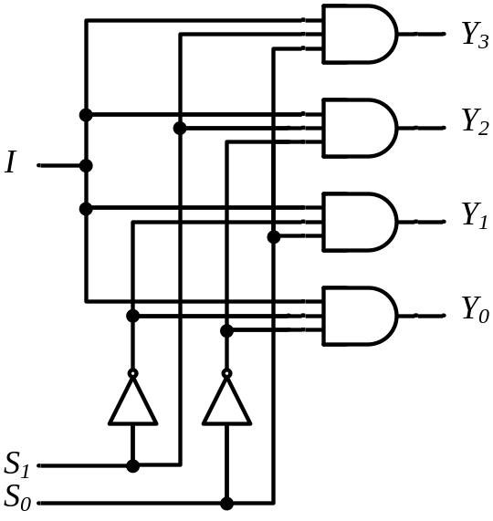
DeMultiplexers
DeMUX
Y3
Y2
Y1
Y0
I
S1 S0
S1 S0 | Y3 | Y2 | Y1 | Y0
0 0 | 0 | 0 | 0 | I
0 1 | 0 | 0 | I | 0
1 0 | 0 | I | 0 | 0
1 1 | I | 0 | 0 | 0
Notes:
Princess Sumaya University
4241 - Digital Logic Design
Dr. Bassam Kahhaleh

Slide 24









Multiplexer / DeMultiplexer Pairs
MUX
DeMUX
Y7
Y6
Y5
Y4 Y3
Y2
Y1
Y0
I7
I6
I5
I4 I3
I2
I1
I0
Y
I
S2 S1 S0
S2 S1 S0
Synchronize
x2 x1 x0
y2 y1 y0
Notes:
Princess Sumaya University
4241 - Digital Logic Design
Dr. Bassam Kahhaleh

Slide 25
DeMultiplexers / Decoders
DeMUX
Binary
Decoder
Y3
Y2
Y1
Y0
Y3
Y2
Y1
Y0
I1
I0
E
I
S1 S0
E | I1 I0 | Y3 Y2 Y1 Y0
0 | x x | 0 0 0 0
1 | 0 0 | 0 0 0 1
1 | 0 1 | 0 0 1 0
1 | 1 0 | 0 1 0 0
1 | 1 1 | 1 0 0 0
S1 S0 | Y3 | Y2 | Y1 | Y0
0 0 | 0 | 0 | 0 | I
0 1 | 0 | 0 | I | 0
1 0 | 0 | I | 0 | 0
1 1 | I | 0 | 0 | 0
Notes:
Princess Sumaya University
4241 - Digital Logic Design
Dr. Bassam Kahhaleh

